Slide 1


Introduction to Spatial Data Exploration using spatstat
Post-EEID Workshop:
Shaun Keegan
Institute of Integrative Biology, University of Liverpool

Slide 2
Learning Outcomes
Introduction to Spatial Data Exploration using spatstat
Be introduced to spatstat
To generate point patterns
To generate and edit density plots
To be familiar with the concept of the K function
To be able to generate K functions
To be able to specify K function parameters to gain a full understanding of the spatial processes in your data
To generate the L function

Slide 3
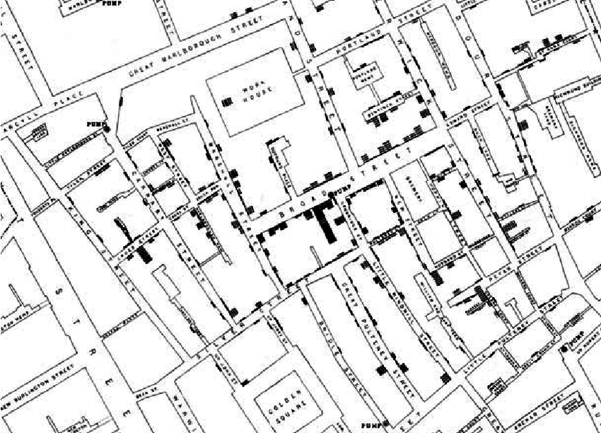
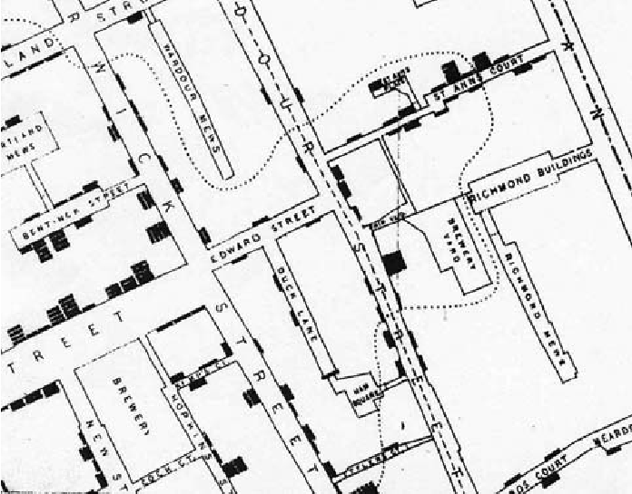
Introduction
Introduction to Spatial Data Exploration using spatstat

Slide 4
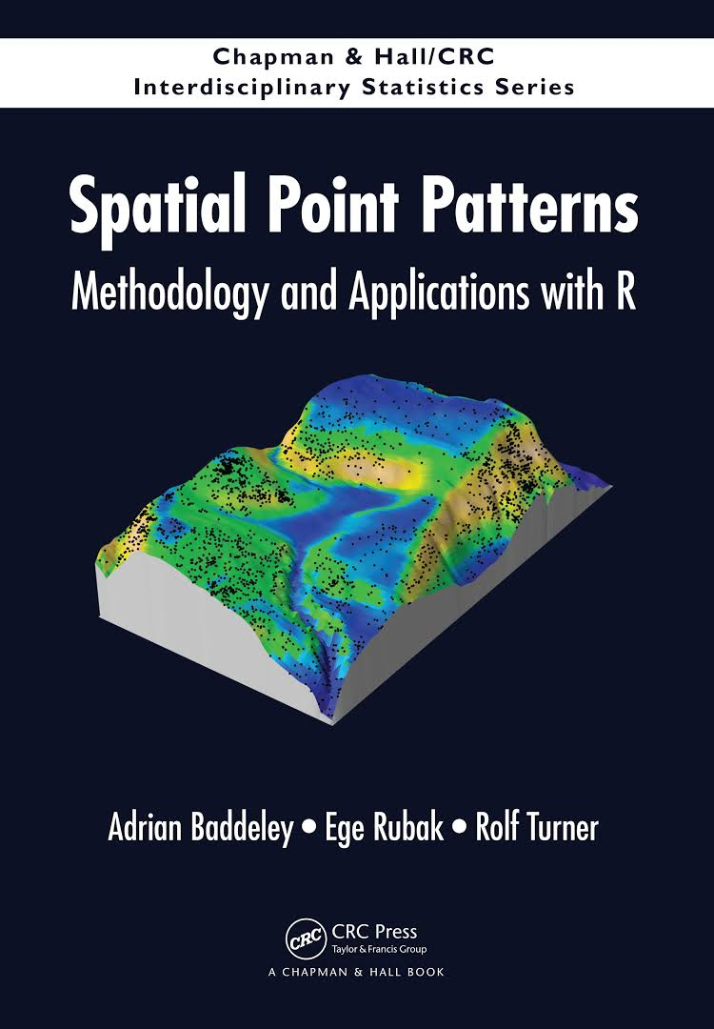
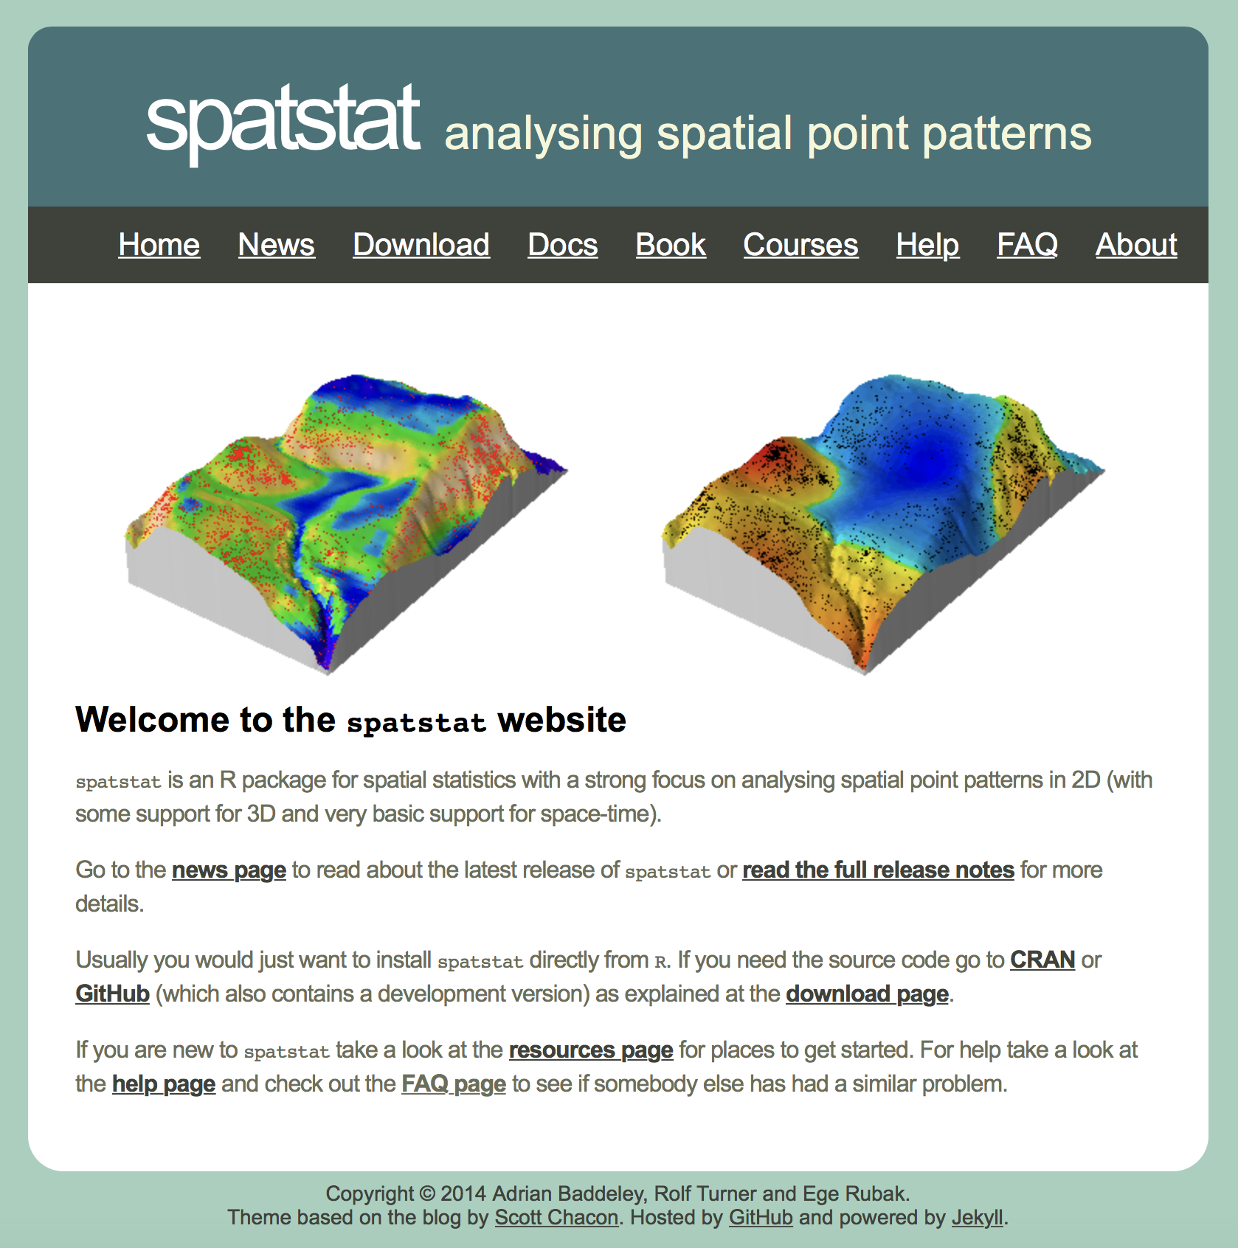
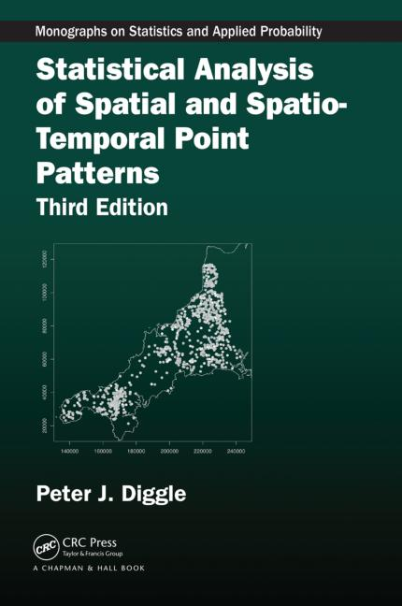
Resources
Introduction to Spatial Data Exploration using spatstat

Slide 5
Before the Session…
Introduction to Spatial Data Exploration using spatstat
Should have installed the package spatstat:
install.packages(“spatstat”)
Why spatstat?
Spatstat is exceptionally simple to use
Easy to generate a number of visual outputs to analyse spatial data
Powerful tool and accessible to beginners

Slide 6
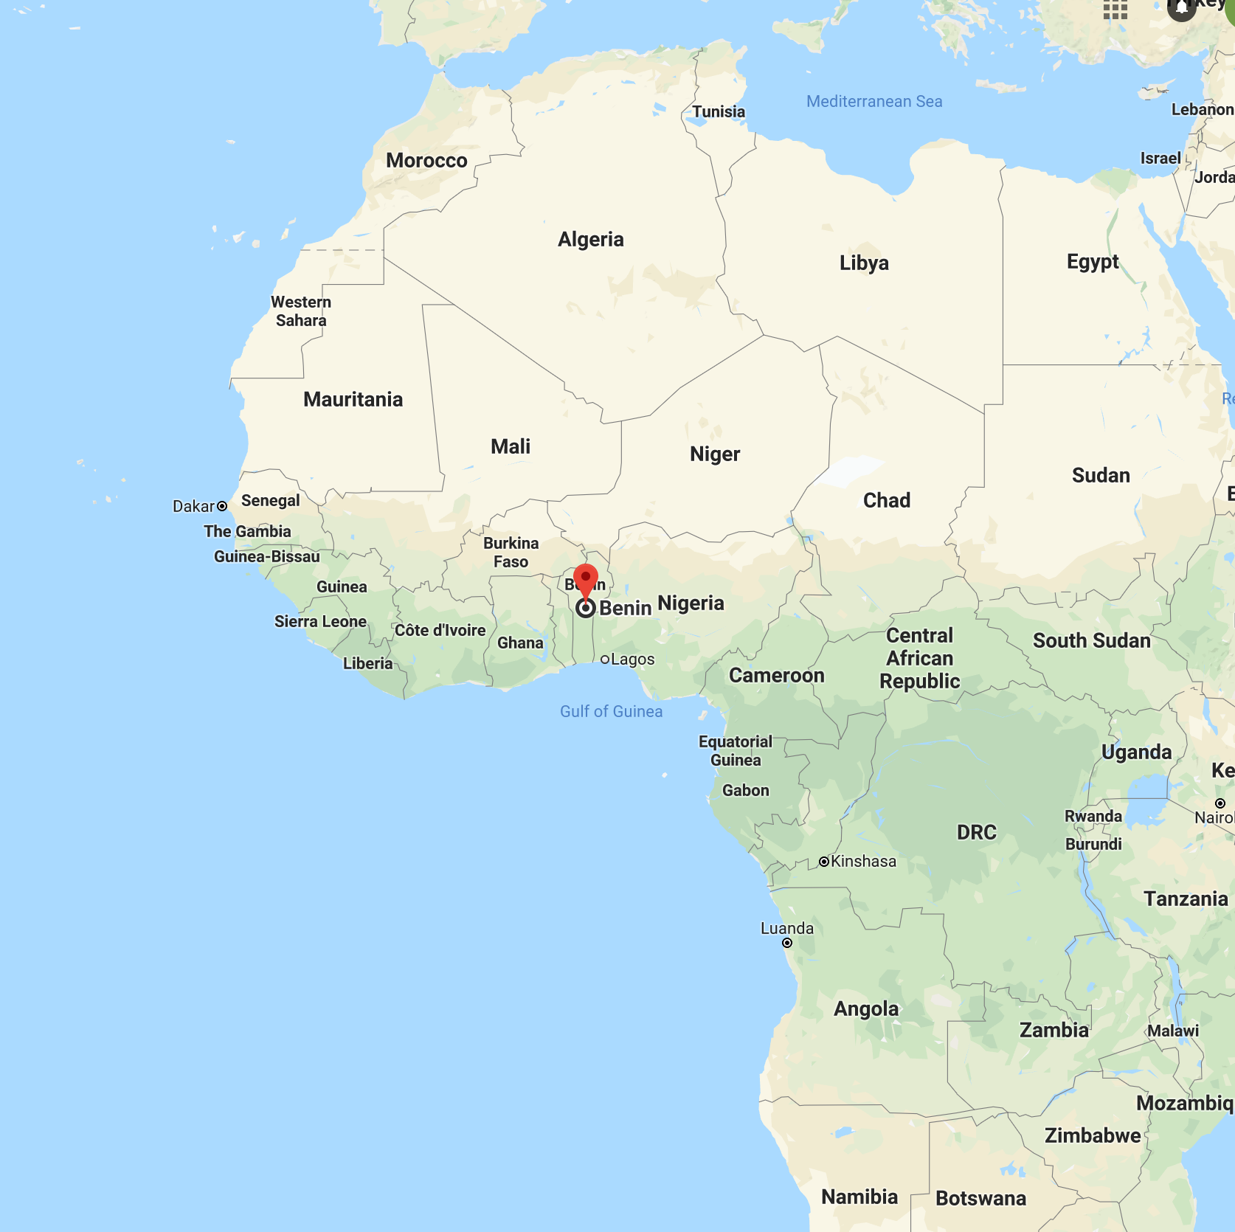
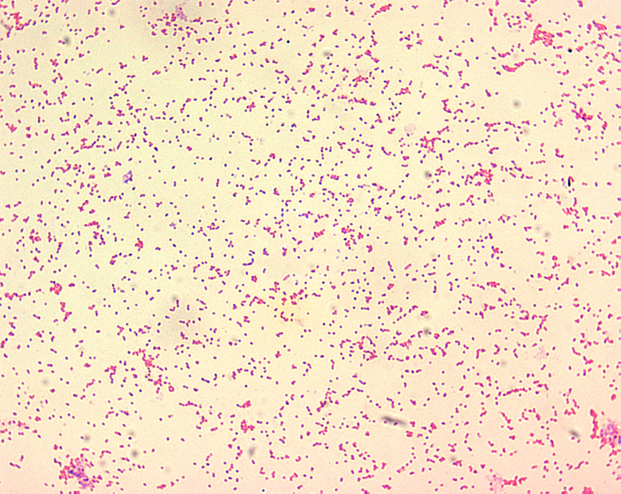
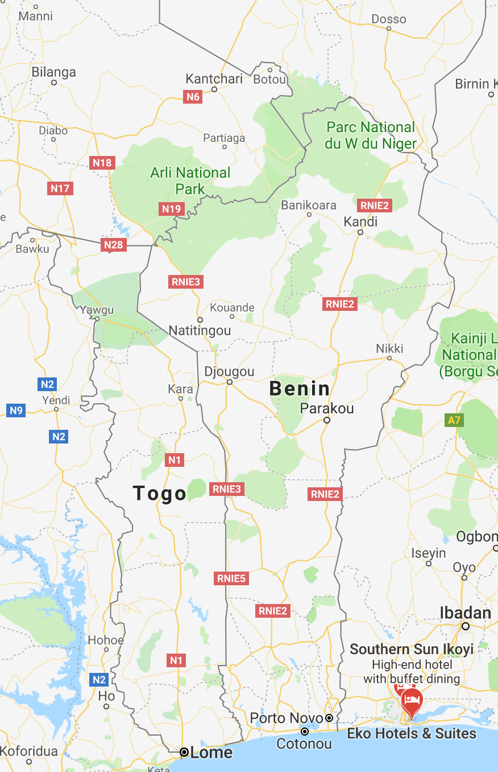
Data
Introduction to Spatial Data Exploration using spatstat
We will use data of Brucellosis cases in Benin:
Campbell LP, Finley AO, Benbow ME, Gronseth J, Small P, Johnson RC, Sopoh GE, Merritt RM, Williamson H, Qi J (2015) Spatial analysis of anthropogenic landscape disturbance and Buruli ulcer disease in Benin. PLOS Neglected Tropical Diseases 9(10): e0004123. https://doi.org/10.1371/journal.pntd.0004123

Slide 7
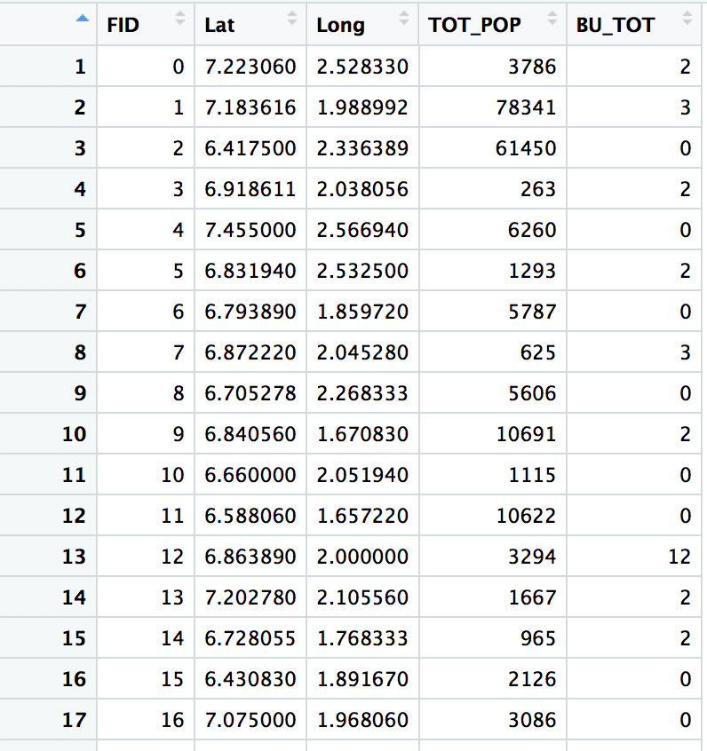
Data
Introduction to Spatial Data Exploration using spatstat
We will use data of Brucellosis cases in Benin:
setwd (”…")
data <- read.csv("BU_data.csv", header = T)
View(data)
data$Infec <- ifelse(data$BU_TOT > 0, 1, 0)
datInf <- data[which (data$Infec == 1),]

Slide 8
What is a Point Pattern?
Introduction to Spatial Data Exploration using spatstat

Slide 9
Creating a Point Pattern
Introduction to Spatial Data Exploration using spatstat
y2
To create a point pattern we need:
X coordinates
Y coordinates
Window – the boundary that all X and Y coordinates fall within
In R we set our window for square or rectangular areas simply by:
win <- as.owin(c(x1, x2, y1, y2)) [DON’T CODE THIS]
For more complex areas, e.g. a country, we would need to upload a shape file. For now we will use a subset of our data to do some initial analyses.
win <- as.owin (c(1.7, 2.6, 6.5, 7.2))
y1
x1
x2

Slide 10
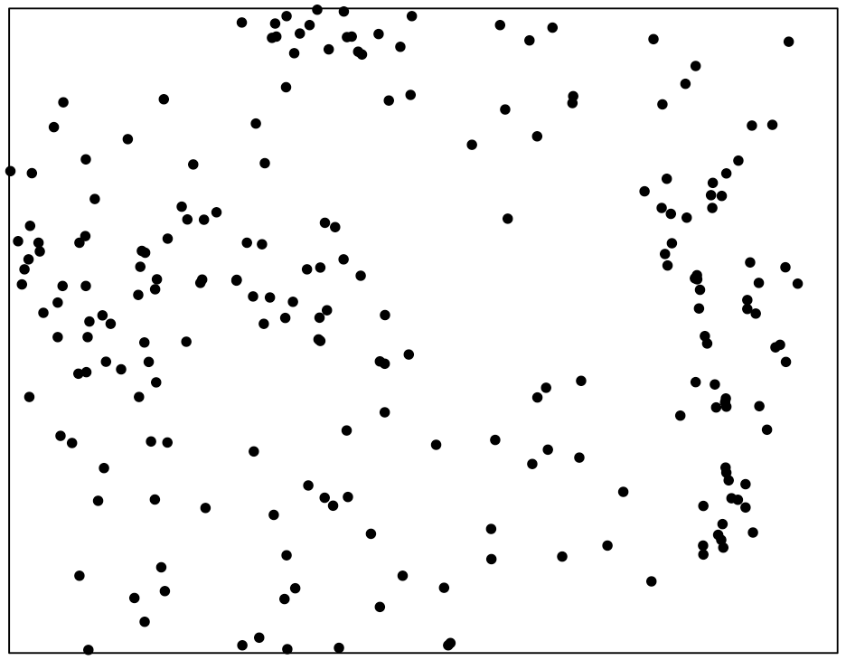
Plotting your Point Patten
Introduction to Spatial Data Exploration using spatstat
setwd (”…")
data <- read.csv("BU_data.csv", header = T)
coords <- cbind(data$Long, data$Lat)
pp <- as.ppp(coords, win)
plot(win)
points(pp)

Slide 11
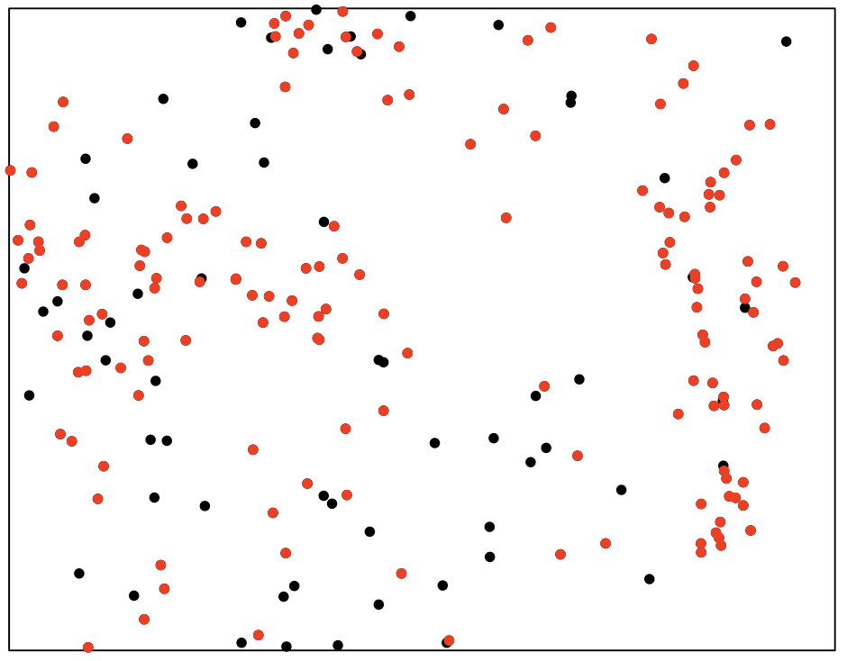
Overlaying your Infection Point Patten
Introduction to Spatial Data Exploration using spatstat
coordsINF <- cbind(datInf$Long,datInf$Lat)
pp.inf <- as.ppp(coordsINF, win)
points(pp.inf, col = "red")

Slide 12
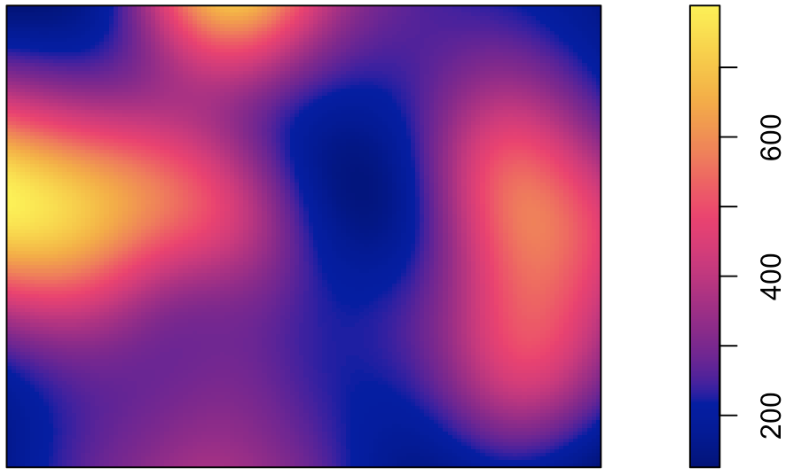
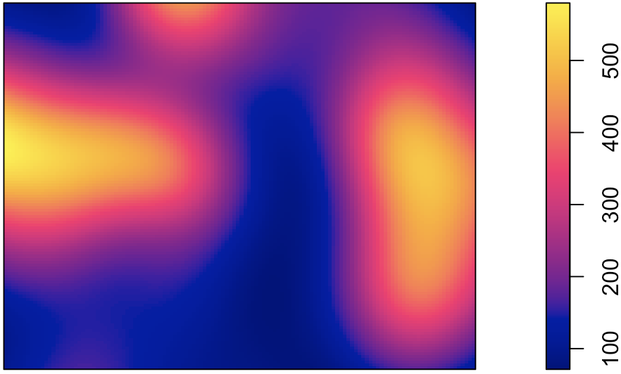
Density
Introduction to Spatial Data Exploration using spatstat
We will investigate some initial density plots:
dens.loc <- density(pp)
dens.inf <- density(pp.inf)
par(mfrow=c(2,1))
plot(dens.loc)
plot(dens.inf)

Slide 13
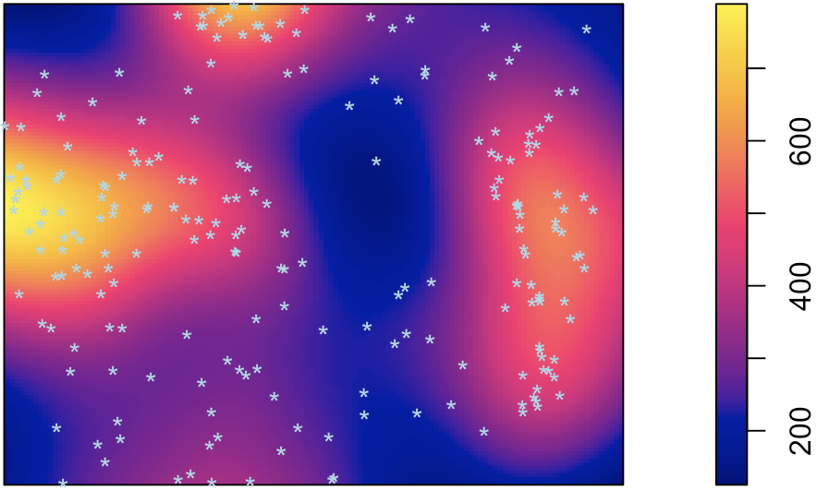
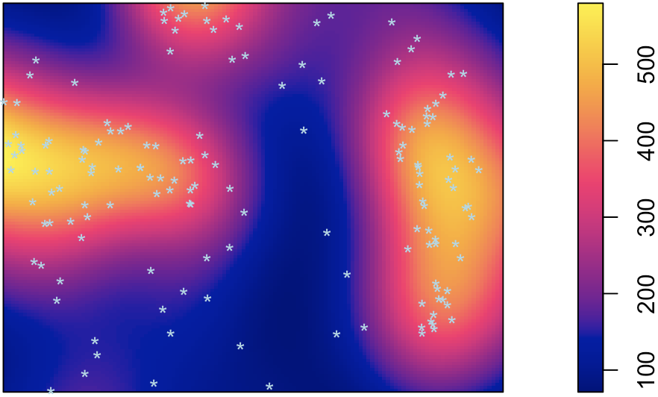
Density
Introduction to Spatial Data Exploration using spatstat
We will investigate some initial density plots:
plot(dens.loc)
points(pp, col = "lightblue", pch = "*")
plot(dens.inf)
points(pp, col = "lightblue", pch = "*")

Slide 14
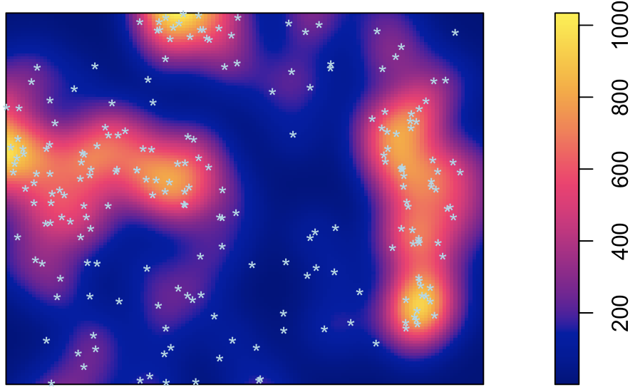
Density
Introduction to Spatial Data Exploration using spatstat
We will investigate some initial density plots:
dens.inf.sigma1 <- density(pp.inf)
plot(dens.inf.sigma1)
points(pp, col = "lightblue", pch = "*")
dens.inf.sigma2 <- density(pp.inf,
sigma = bw.ppl(pp.inf))
plot(dens.inf.sigma2)
points(pp, col = "lightblue", pch = "*")

Slide 15
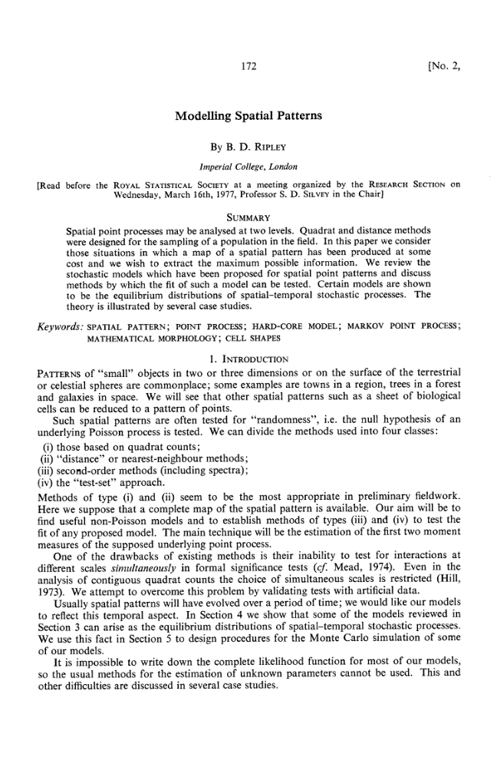
The K Function
Introduction to Spatial Data Exploration using spatstat
This is a popular technique for analysing correlation in spatial point patterns.
Proposed by Brian Ripley in 1977.
In a nutshell:
K(r) is the average number of neighbours of a typical point divided by the average number of points per unit area, or the intensity.
Ripley, B. D., Modelling Spatial Patterns
Journal of the Royal Statistical Society. Series B (Methodological)
Vol. 39, No. 2 (1977), pp. 172-212

Slide 16
The K Function
Introduction to Spatial Data Exploration using spatstat

Slide 17
The K Function
Introduction to Spatial Data Exploration using spatstat
r
r
r

Slide 18
The K Function
Introduction to Spatial Data Exploration using spatstat
par(mfrow = c(1,1))
K <- (Kest(pp.inf))
plot(K)

Slide 19
The K Function
Introduction to Spatial Data Exploration using spatstat
Krmax <- (Kest(pp.inf, rmax = 0.5))
plot(Krmax)

Slide 20
The K Function - envelopes
Introduction to Spatial Data Exploration using spatstat
Acceptance Interval:
Kenv <- (envelope(pp.inf, fun = Kest,
correction = “iso”))
plot(Kenv)

Slide 21
The K Function - envelopes
Introduction to Spatial Data Exploration using spatstat
Acceptance Interval:
Kenvrmax <- (envelope(pp.inf, fun = Kest,
correction = "iso", rmax = 0.4))
plot(Kenvrmax)

Slide 22
The K Function - envelopes
Introduction to Spatial Data Exploration using spatstat
Acceptance Interval:
par(mfrow = c(1,2))
Kenv <- (envelope(pp.inf, fun = Kest,
correction = "iso"))
plot(Kenv)
Confindence Interval:
Kloh <- (lohboot(pp.inf, fun = Kest,
correction = "iso"))
plot(Kenv)

Slide 23
Transformations of K
Introduction to Spatial Data Exploration using spatstat
We can transform the K function to the L function:
Lenvrmax <- (envelope(pp.inf, fun = Lest,
correction = "iso", rmax = 0.4))
plot(Lenvrmax)

Slide 24
Other Analyses
Introduction to Spatial Data Exploration using spatstat
Allstats <- (pp.inf)
plot(Allstats)
Spatstat can be used to ask a wide variety of statistical questions:
E.g. functions such as:
Point pattern models
Permutation tests for differences between groups of point patterns

Slide 25

Data specific questions?
Contact:
Shaun.Keegan@Liverpool.ac.uk
@SP_Keegan
Presentation and Code Files:
https://github.com/shaunkeegan/intro_to_spatstat
WANT TO LEARN MORE ABOUT MANAGING SPATIAL DATA IN R?
BES QUANTITATIVE ECOLOGY SIG WILL BE HOSTING AN EVENT THIS AUTUMN
FOLLOW OUR TWITTER FOR FURTHER INFORMATION - @BES_QE_SIG

